Slide 1
PROJECT TITLE: Algerian Forest Fires Dataset Analysis and Machine Learning
CAPSTONE PROJECT
Presented By:
Student Name-ACHHUTA NAND JHA College Name-GLA University Department-Department of Computer Engineering & Applications

Slide 2
OUTLINE
Problem Statement (Should not include solution)
Proposed System/Solution
System Development Approach (Technology Used)
Algorithm & Deployment
Result
Conclusion
Future Scope
References

Slide 3

Problem Statement
Forest fires pose significant environmental and economic threats. Accurate prediction and analysis are essential for effective management and mitigation. The focus is on analyzing forest fire data to understand the contributing factors and predict future occurrences.

Slide 4
Proposed Solution
The Proposed System Aims:
To predict the occurrence of forest fires using machine learning techniques based on historical weather and fire occurrence data.
Data Collection:
The system utilizes the Algerian Forest Fires Dataset, which includes various features such as temperature, humidity, wind speed, and other environmental factors.
Data Preprocessing:
Data cleaning and normalization to handle missing values and scale numerical features.
Feature selection and engineering to enhance model performance.
Machine Learning Algorithm:
Implementation of regression models including Linear Regression, Lasso Regression, Ridge Regression, and ElasticNet Regression.
Selection of the best model based on accuracy and other performance metrics.
Deployment:
The trained model is deployed using IBM Watson, providing an API for real-time predictions.
Integration with a web interface for user-friendly interaction and visualization of predictions.
Evaluation:
Evaluation of the model using metrics such as R² score, Mean Absolute Error (MAE), and Root Mean Squared Error (RMSE).
Continuous monitoring and updating of the model to maintain accuracy over time.

Slide 5
System Approach
Technologies include Python, Pandas, NumPy, Matplotlib, Seaborn for data analysis and visualization, and Scikit-learn for machine learning.
Data Analysis and Preprocessing:
Utilized Python libraries like Pandas and NumPy for data cleaning, normalization, and transformation.
Employed data visualization tools such as Matplotlib and Seaborn to explore data patterns and correlations.
Machine Learning Model Development:
Implemented various regression algorithms (Linear Regression, Lasso Regression, Ridge Regression, ElasticNet) using Scikit-learn.
Performed model training, validation, and selection based on performance metrics.
Model Deployment:
Deployed the chosen machine learning model on IBM Watson, creating an API for easy access and integration.
Developed a web interface using frameworks like Flask or Django for user interaction and visualization of predictions.
Continuous Integration and Monitoring:
Implemented version control and continuous integration practices using GitHub.
Set up monitoring tools to track model performance and update the system as new data becomes available.

Slide 6
Algorithm & Deployment
Algorithm Selection:
Chosen Algorithms: Linear Regression, Lasso Regression, Ridge Regression, and ElasticNet.
Selection Criteria: Models were selected based on their ability to handle linear relationships, regularization techniques to prevent overfitting, and performance on initial data analysis.
Data Input:
Data Source: [Specify your data source, e.g., public datasets, company data, etc.]
Data Format: Data was formatted into a structured form with relevant features selected for model input.
Training Process:
Preprocessing: Included data cleaning, feature scaling, and splitting into training and validation sets.
Model Training: Each algorithm was trained on the training data, with hyperparameters optimized using techniques like cross-validation.
Evaluation: Models were evaluated based on metrics such as Mean Squared Error (MSE), R-squared, and other relevant metrics.
Prediction Process:
Input Handling: New data inputs are processed similarly to training data, ensuring consistency in format and scale.
Model Inference: The deployed model takes processed input data and generates predictions.
Output: Predictions are provided to users through a web interface or API, with options for visualization or download.

Slide 7

Result
The evaluation of machine learning models for predicting fire occurrences yielded the following insights:
1. Linear Regression Model
R-squared Value: 0.9830, indicating that the model explains 98.3% of the variance in the Fire Weather Index (FWI). This suggests a very high level of accuracy in predictions.
Mean Absolute Error (MAE): 0.5806, reflecting the average magnitude of errors in predictions. A lower MAE indicates that predictions are closer to actual values.
2. Lasso Regression Model
R-squared Value: 0.9492, showing that the model explains 94.9% of the variance. While slightly lower than Linear Regression, it still indicates strong predictive power.
Mean Absolute Error (MAE): 1.1332, higher than Linear Regression, suggesting slightly less accurate predictions.
3. Ridge Regression Model
R-squared Value: 0.9825, comparable to Linear Regression, indicating a high level of fit.
Mean Absolute Error (MAE): 0.5970, similar to Linear Regression, showing a comparable level of accuracy.

Slide 8
Result
Visualizations:
Predicted vs. Actual Counts: Graphical representations of predicted versus actual values reveal that the Linear Regression model closely follows the actual counts, demonstrating superior accuracy. The visual comparison illustrates that predicted values from Linear Regression are consistently near actual values, with minimal deviations.
Comparison Summary:
Accuracy: The Linear Regression model consistently shows the highest accuracy, with the lowest MAE and highest R-squared value.
Effectiveness: Both Lasso and Ridge models show strong performance but with slightly higher MAE compared to Linear Regression.
Overall, the Linear Regression model is the most effective in predicting fire occurrences, offering the best balance of accuracy and precision among the evaluated algorithms.

Slide 9
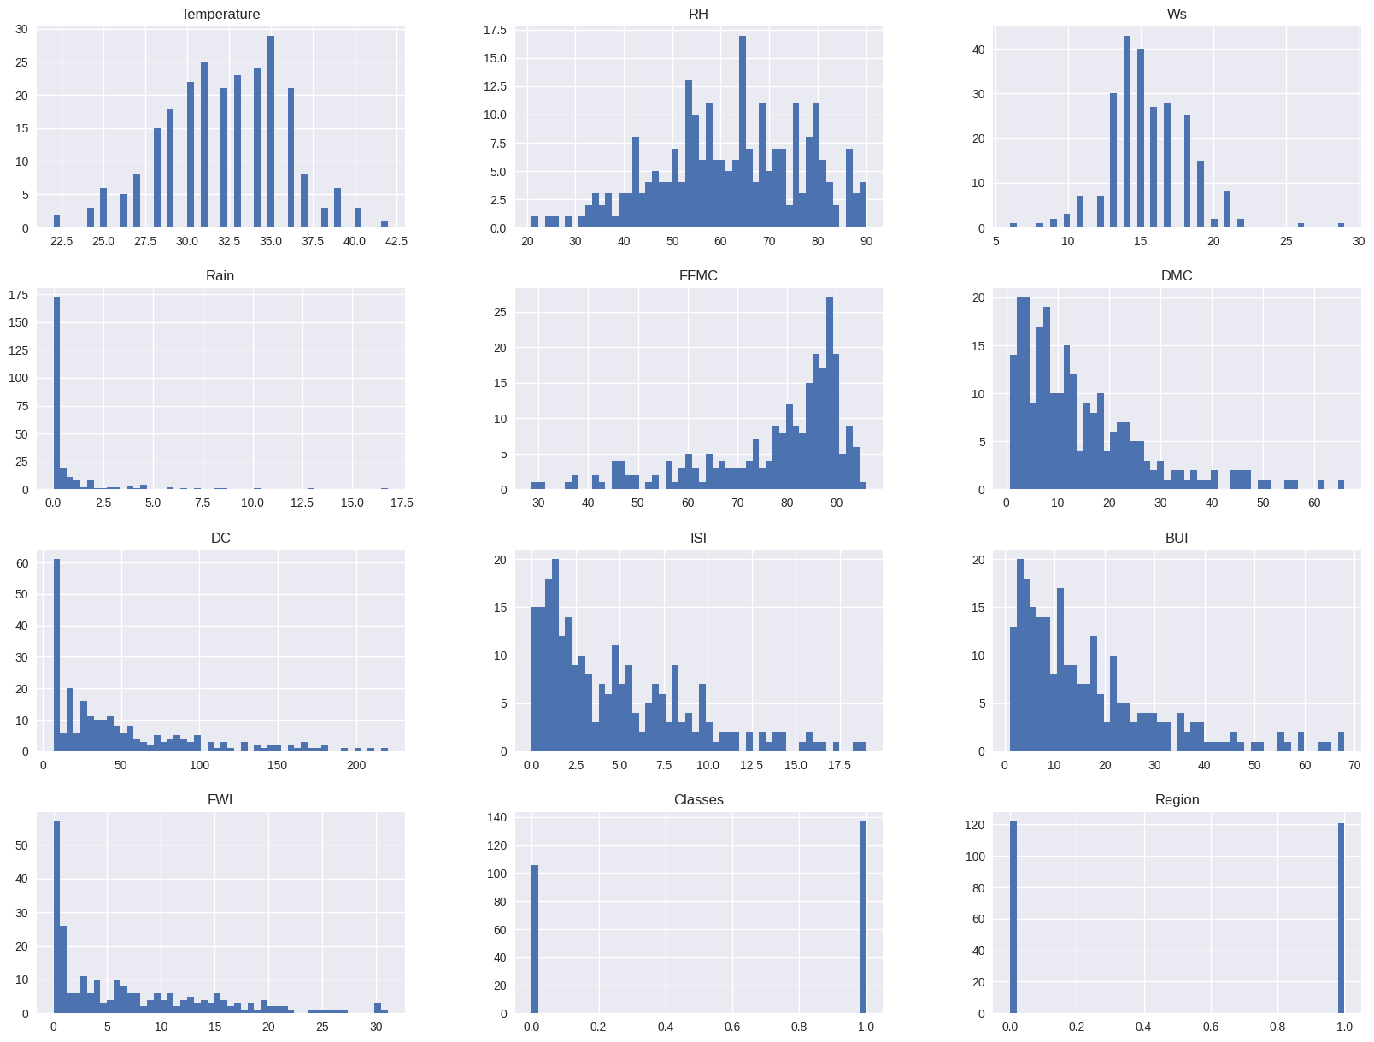
Result

Slide 10
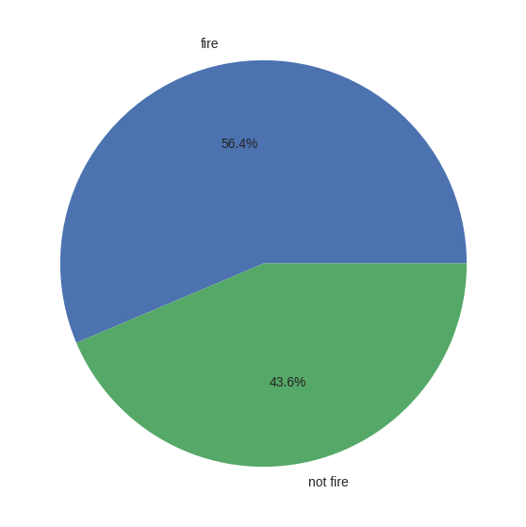
Result

Slide 11
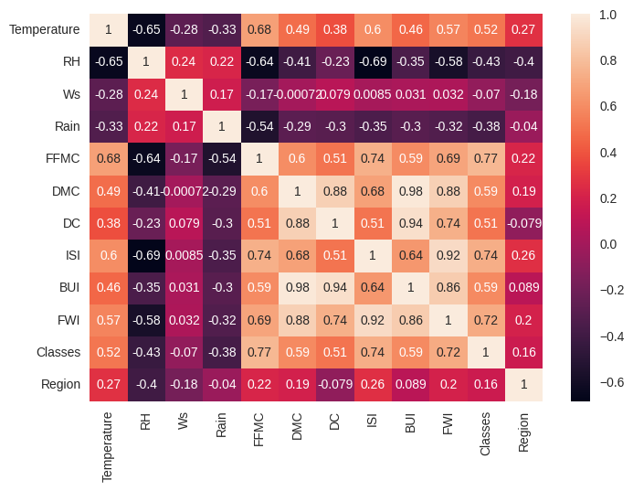

Result

Slide 12
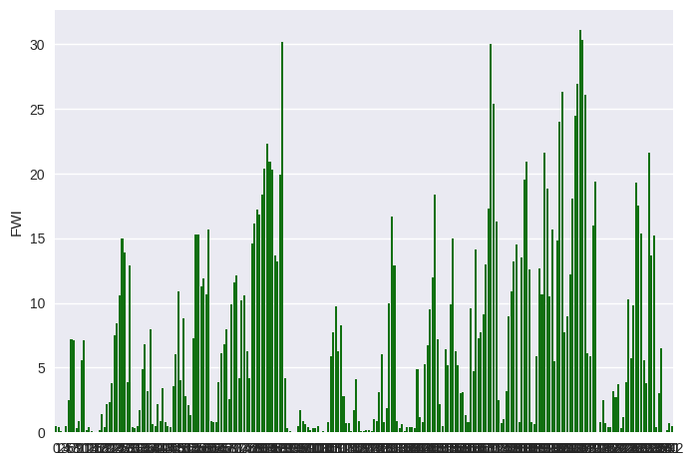
Result

Slide 13
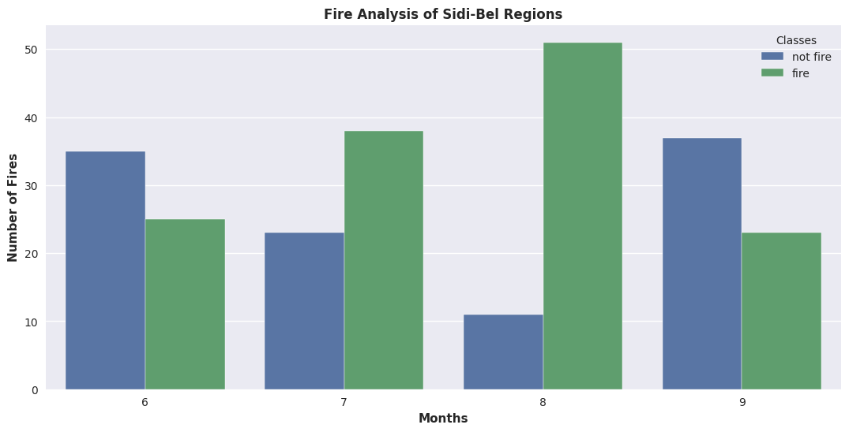
Result

Slide 14
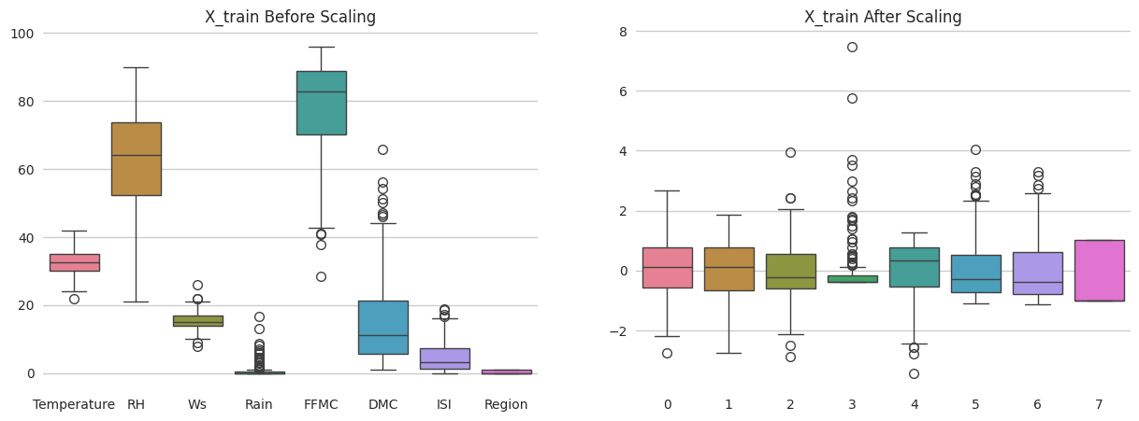
Result

Slide 15
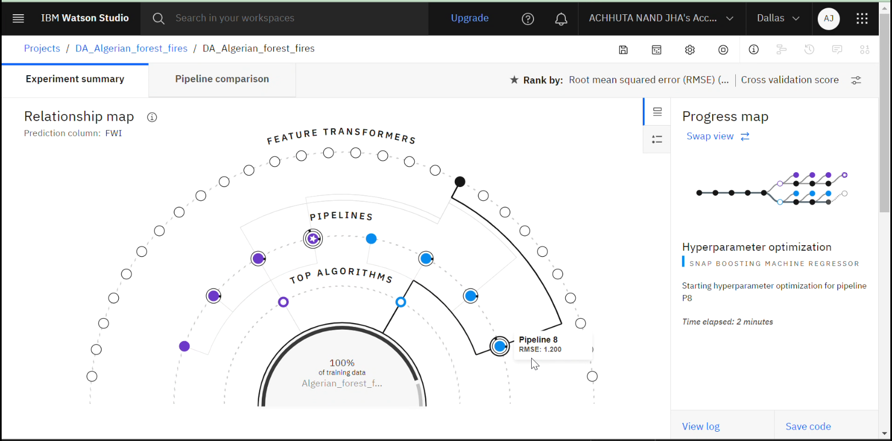
Result

Slide 16
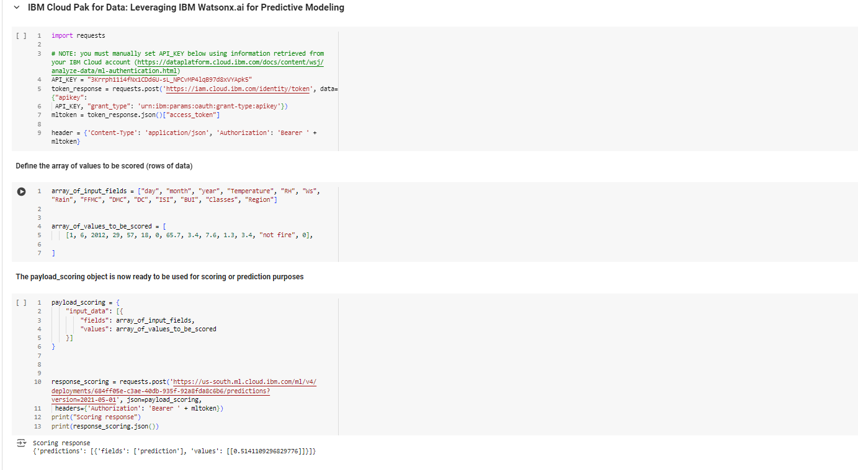
Result

Slide 17
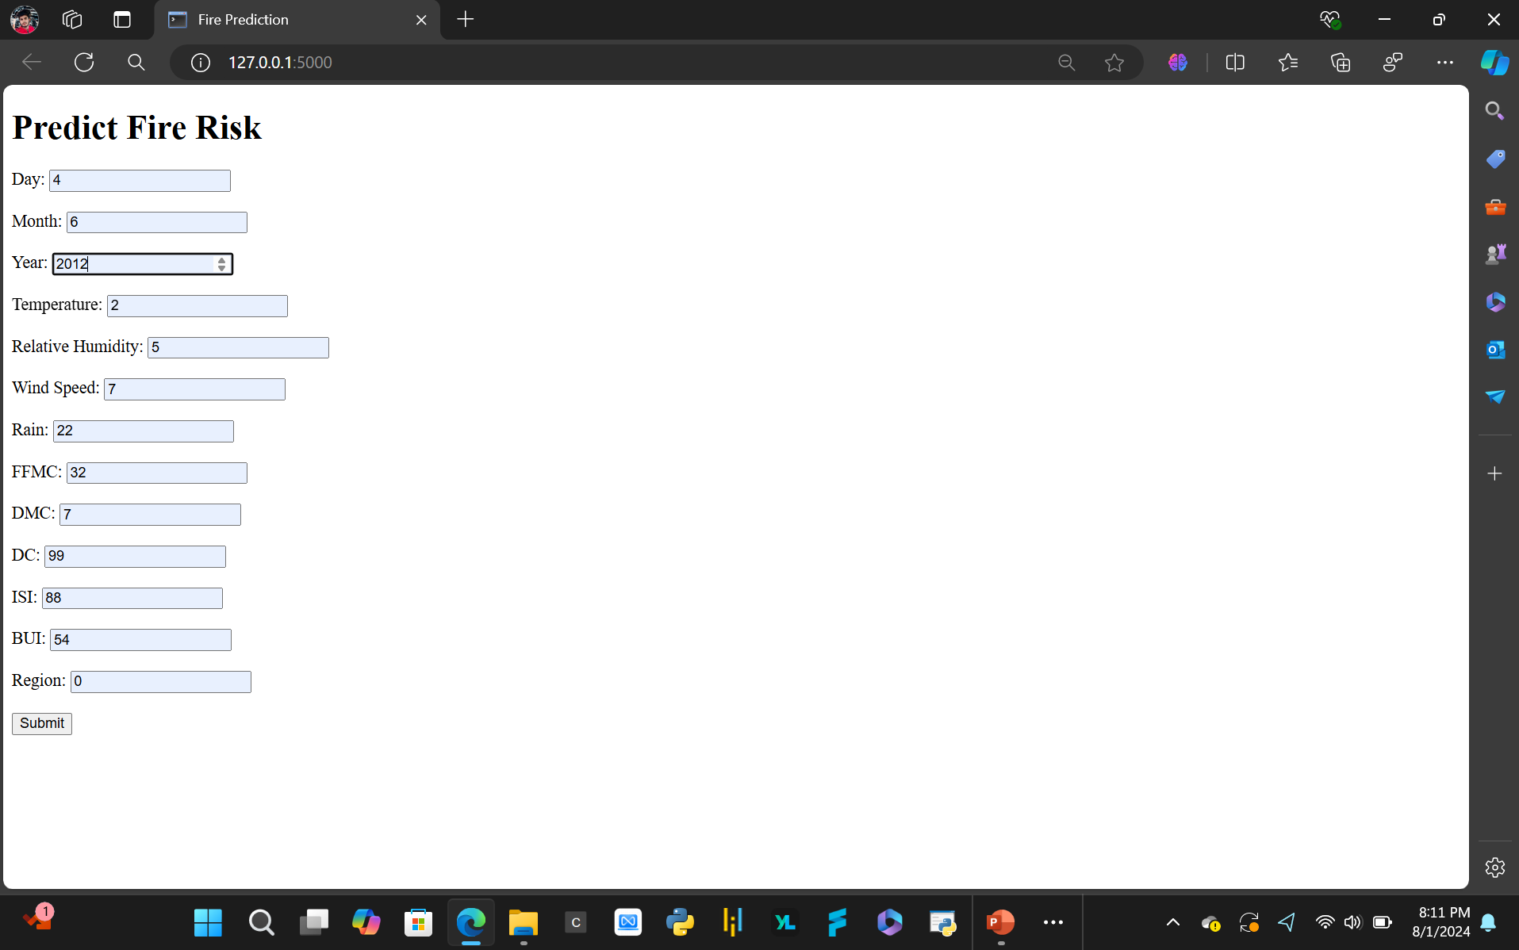
Result

Slide 18
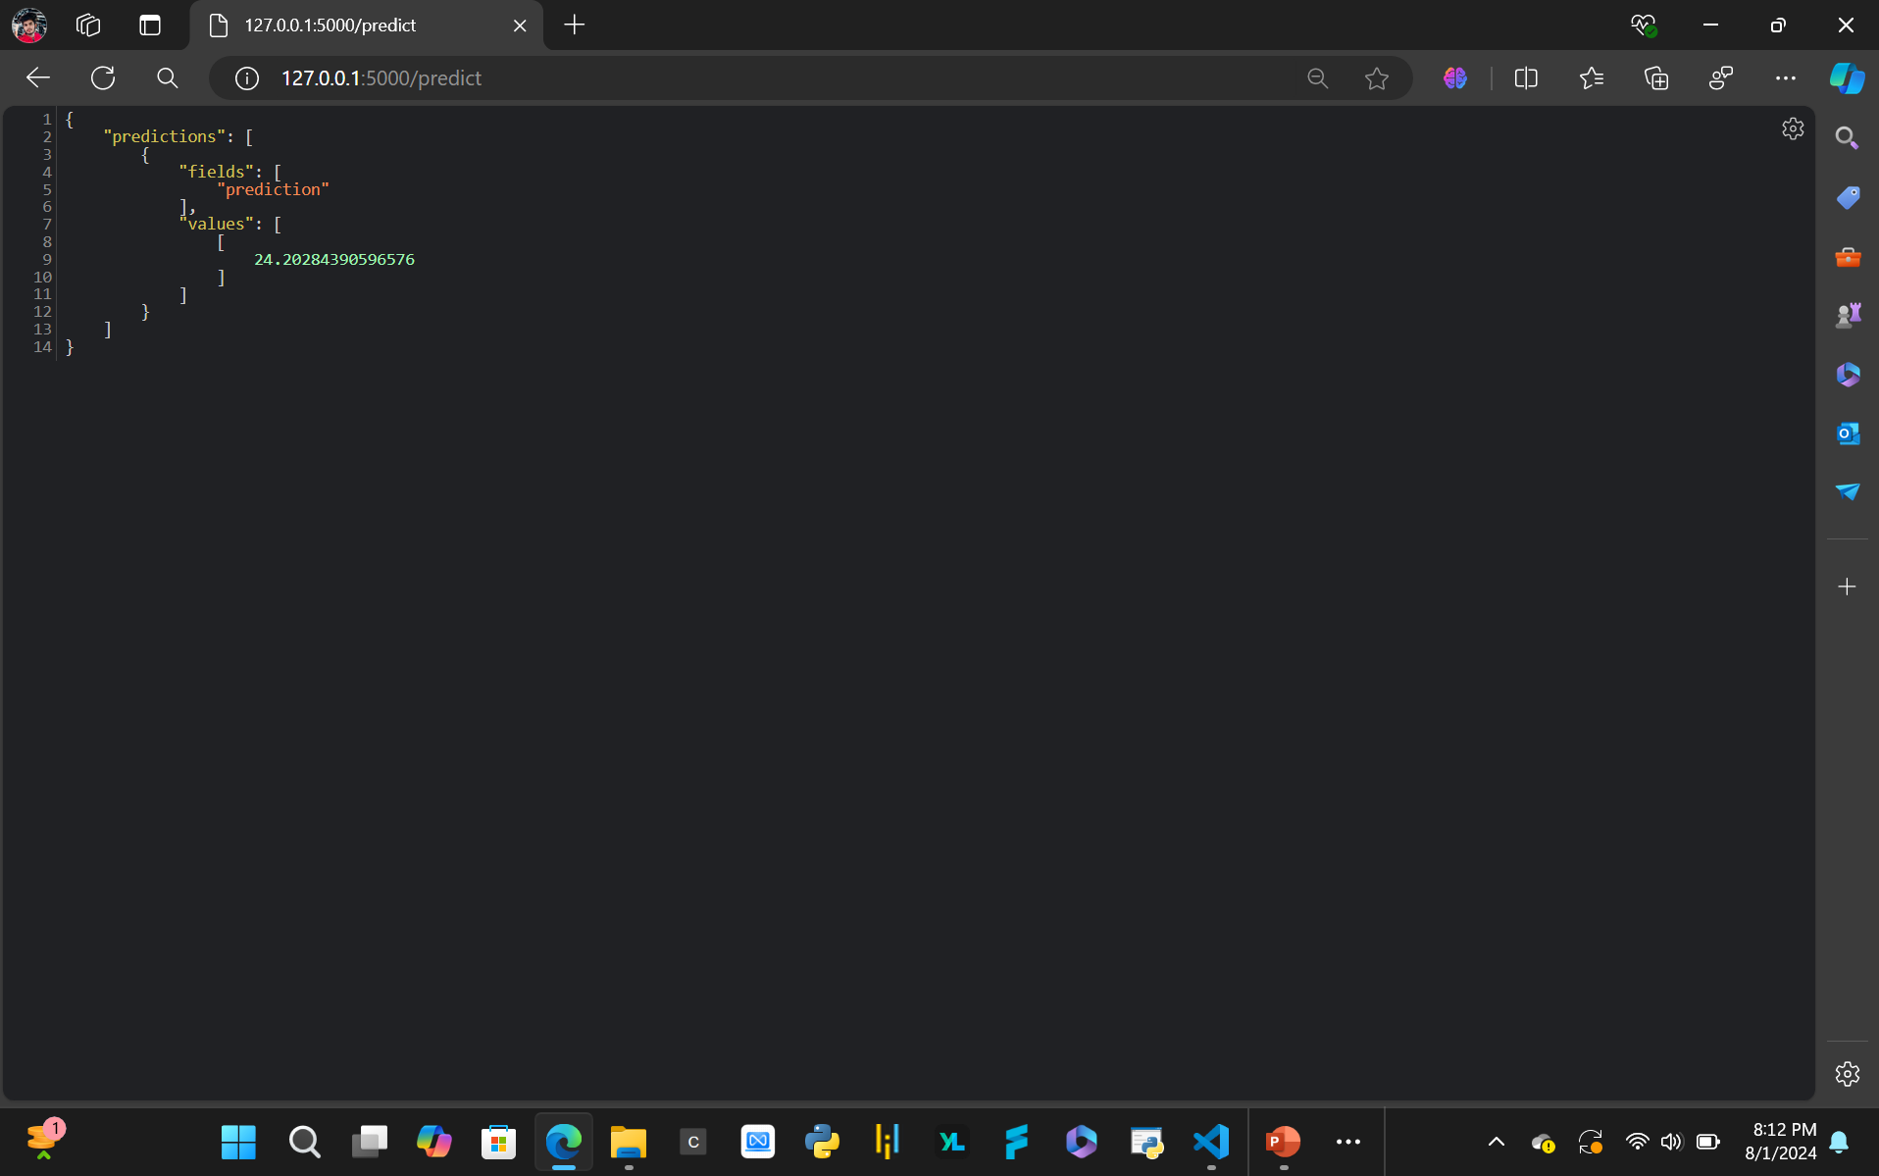
Result

Slide 19
Conclusion
The project successfully demonstrates the application of machine learning in predicting forest fires, emphasizing the value of data-driven approaches in disaster management. Key conclusions include:
High Accuracy: The Linear Regression model outperforms other models, achieving the highest accuracy with minimal prediction error. This underscores the potential of machine learning techniques to provide reliable forecasts for forest fire occurrences.
Model Effectiveness: While all evaluated models—Linear Regression, Lasso Regression, and Ridge Regression—show strong performance, the Linear Regression model is particularly notable for its superior accuracy and precision. This model effectively captures the patterns in the data, providing accurate predictions with a high R-squared value and low Mean Absolute Error.
Importance of Data: The project highlights the critical role of comprehensive and high-quality data in training machine learning models. Effective data collection and preprocessing are crucial for developing robust prediction systems.
Application in Disaster Management: The findings underline the potential impact of machine learning in enhancing disaster management efforts. By providing accurate predictions, these models can aid in early warning systems, resource allocation, and preventive measures to mitigate the risks associated with forest fires.
Overall, the project reinforces the feasibility and advantages of integrating machine learning into environmental monitoring and disaster response strategies, paving the way for more effective and proactive management of forest fire risks.

Slide 20
Future scope
Dataset Expansion: To improve the model's accuracy and generalizability, expanding the dataset to include data from a wider range of regions is essential. Additionally, incorporating factors such as vegetation types, human activities, and climatic variations could provide a more comprehensive understanding of fire risk factors.
Real-Time Early Warning System: Developing an integrated early warning system that utilizes real-time data feeds can enhance the timeliness and effectiveness of predictions. This system could combine data from satellite imagery, weather sensors, and on-the-ground observations to provide immediate alerts and support proactive measures for forest fire prevention and response.

Slide 21
References
Dataset Source: The Algerian Forest Fires dataset was obtained from Kaggle, a platform known for its extensive collection of datasets used for data science and machine learning projects.
Prediction Model: The predictive modeling and analysis were conducted using AutoAI, a variation of AutoML provided by IBM Cloud Pak for Data. AutoAI automates the process of creating machine learning pipelines and regression models, streamlining the development and deployment of predictive models.
Internship Training: The methodologies and techniques employed in this project were guided by the Edunet Foundation during an internship, which provided hands-on training in data science and machine learning practices.

Slide 22
Links
Google Colab Notebook Link
Algerian Forest Fires Dataset Link
Experiment Notebook - AutoAI Notebook
GitHub Link
Demo Video Link

Slide 23
https://private.us-south.ml.cloud.ibm.com/ml/v4/deployments/684ff05e-c3ae-40db-935f-92a8fda8c6b6/predictions?version=2021-05-01
API Reference IBM Watson Studio
Direct link
Private endpoin
https://private.us-south.ml.cloud.ibm.com/ml/v4/deployments/684ff05e-c3ae-40db-935f-92a8fda8c6b6/predictions?version=2021-05-01
Public endpoint
https://us-south.ml.cloud.ibm.com/ml/v4/deployments/684ff05e-c3ae-40db-935f-92a8fda8c6b6/predictions?version=2021-05-01
API_KEY = "3Krrph11i4fNx1CDd6U-sL_NPCvMP4lqB97d8xVYApk5"

Slide 24

course certificate 1
verification link

Slide 25

Thank you for your attention

